Slide 1
WhatsApp’s Event Reminder and Gifting Suite
B Team

Slide 2

Problem Statement:
In our daily lives, we frequently overlook significant dates, including special occasions like the birthdays of those close to us.
9:21 am
Vision:
Our goal is to create a feature in WhatsApp that reminds users to celebrate loved one’s birthdays and milestones, thereby enhancing relationships within its diverse user community.
9:22 am

Slide 3
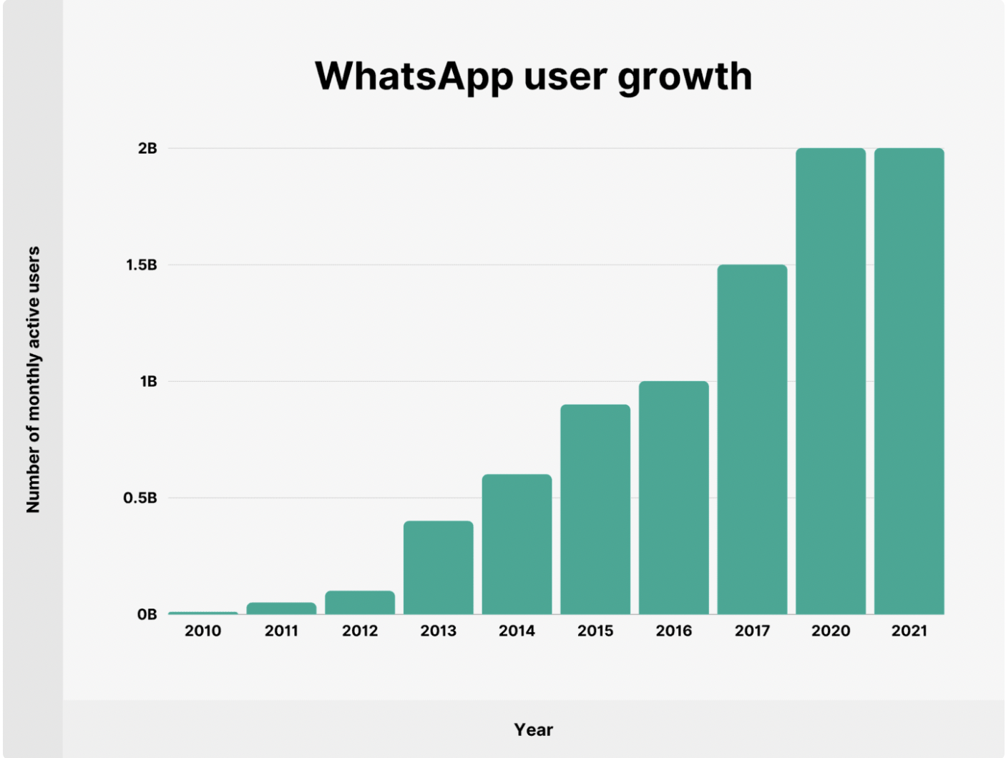
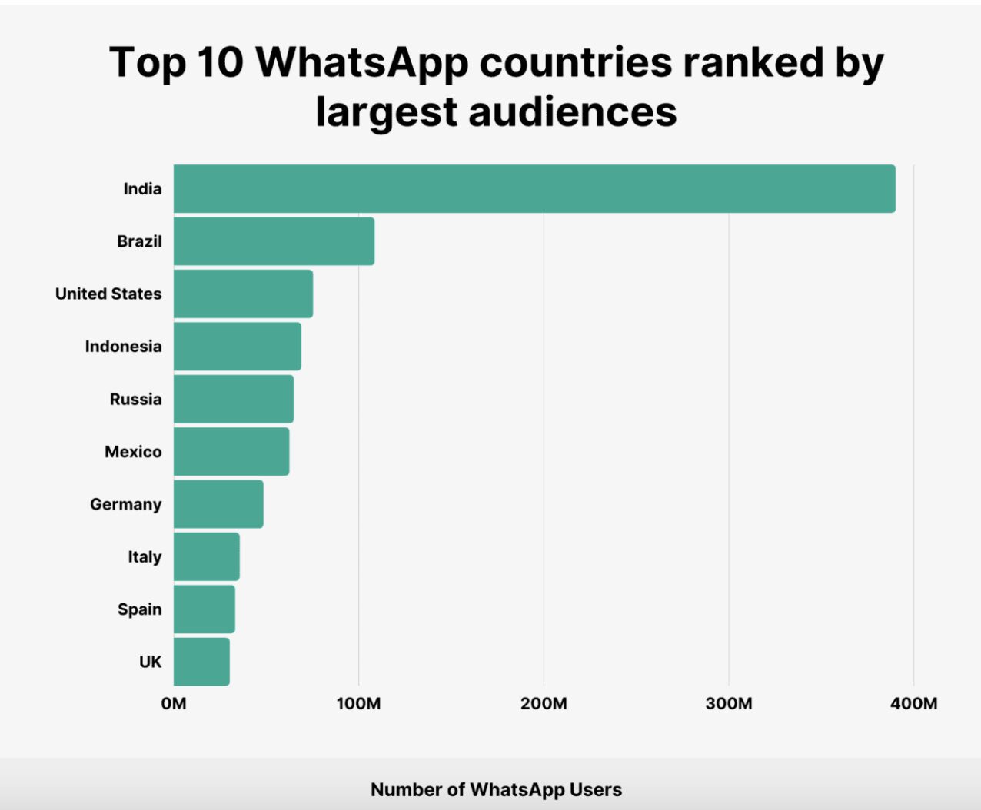
The Demographic of WhatsApp Users

Slide 4
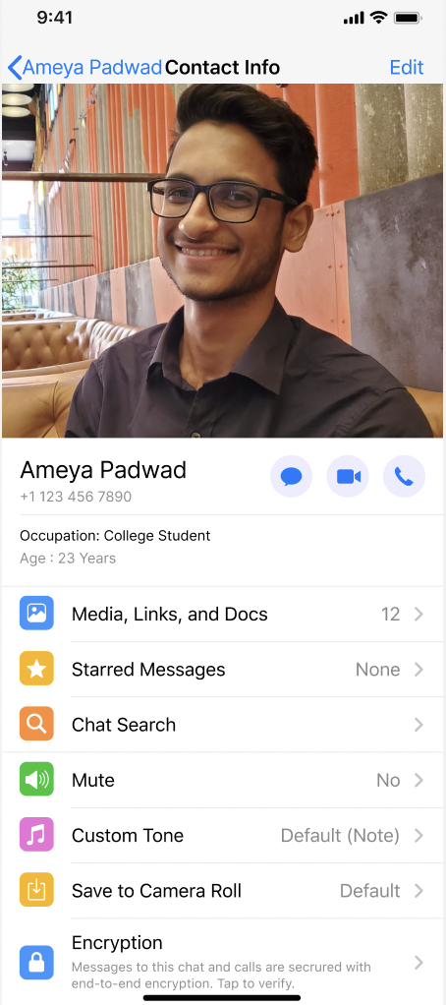
User story

Slide 5
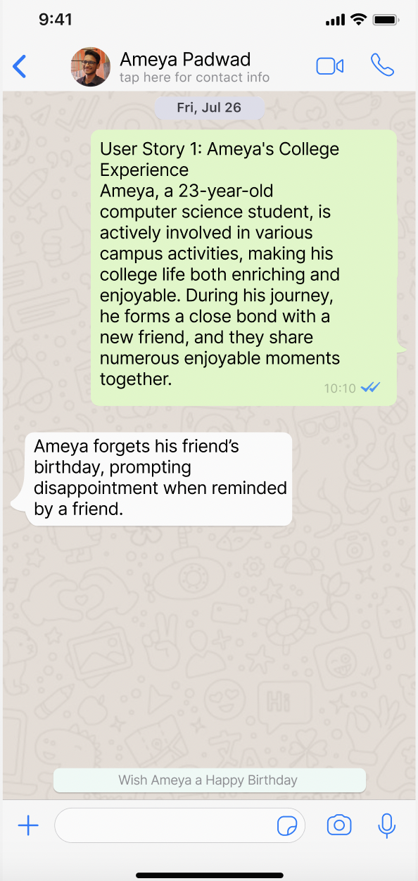
User story

Slide 6
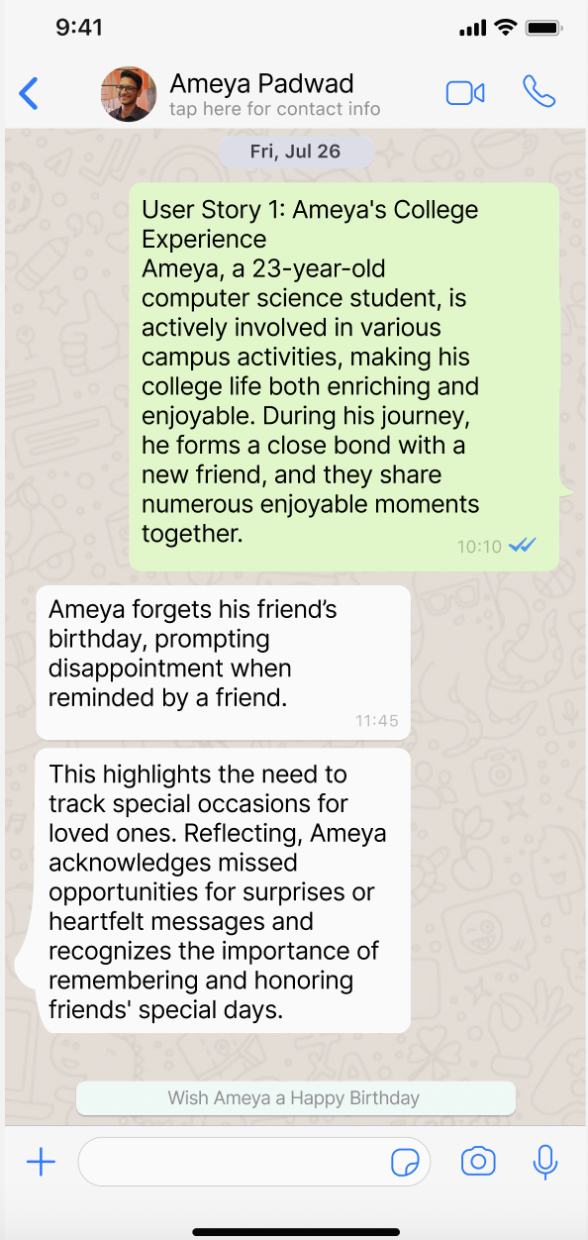
User story

Slide 7
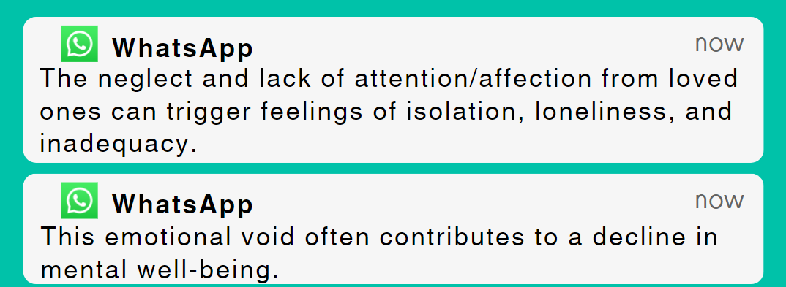
Why?

Slide 8
Proposed Solution
Integrating event reminders and streamlining the process of sending greetings and gifts directly within the platform.
BENEFITS
Eliminates the necessity to depend on additional social media applications for important event dates.
Harnessing the power of the "Payments" feature for seamless gift card sending and B2B integration with other platforms

Slide 9
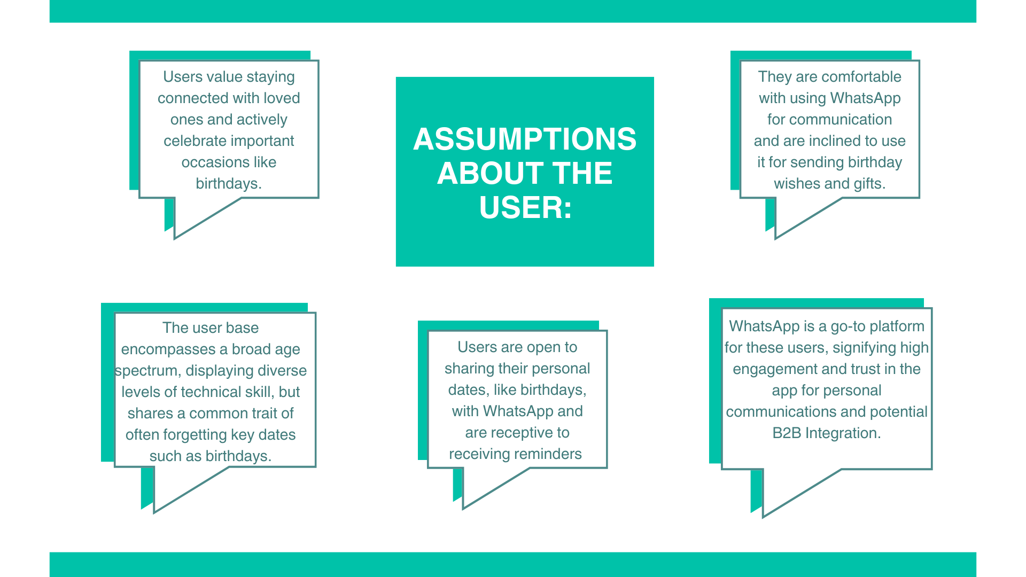

Slide 10




Competitor Analysis
Personalized App for Messaging and Calls | Private Messaging and calling for free | Instant Messaging App. Share photos and videos | Social media platform to share expressions | Professional network for finding jobs and learn
Age Demographics | 24-35 : 84% | 24-35 : 22% | 25-34 : 29.5% | 25-34 : 60%
Payment Gateway | Yes(India, Brazil) | No | No | No
Active User Demographic (Monthly) | Friends and Family Working Professionals Business Promotional | Friends and Family | Friends and Family Business | Working Professionals

Slide 11
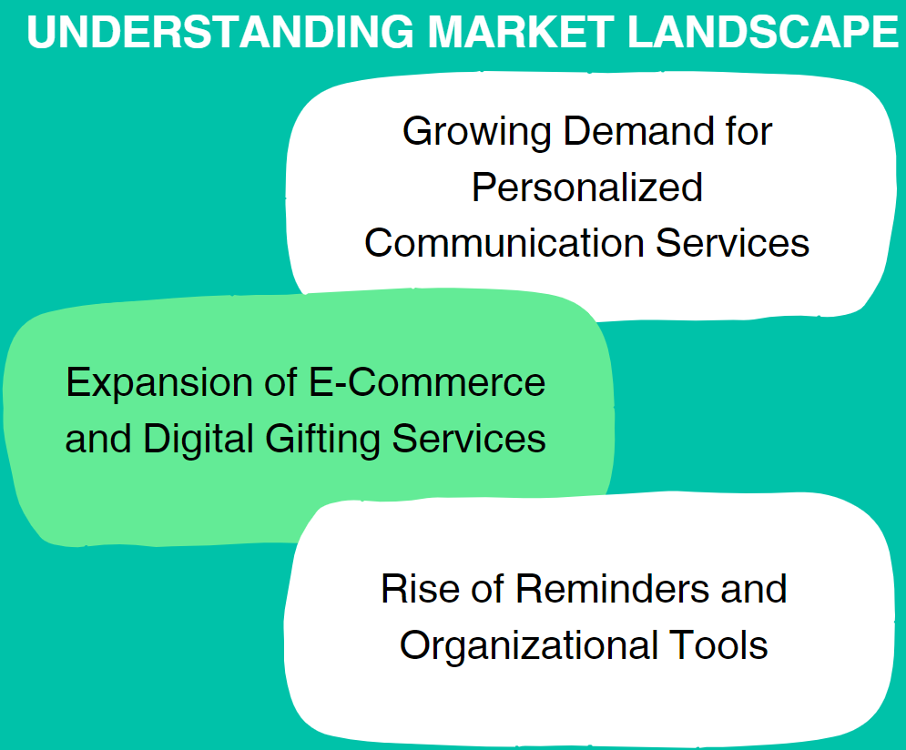
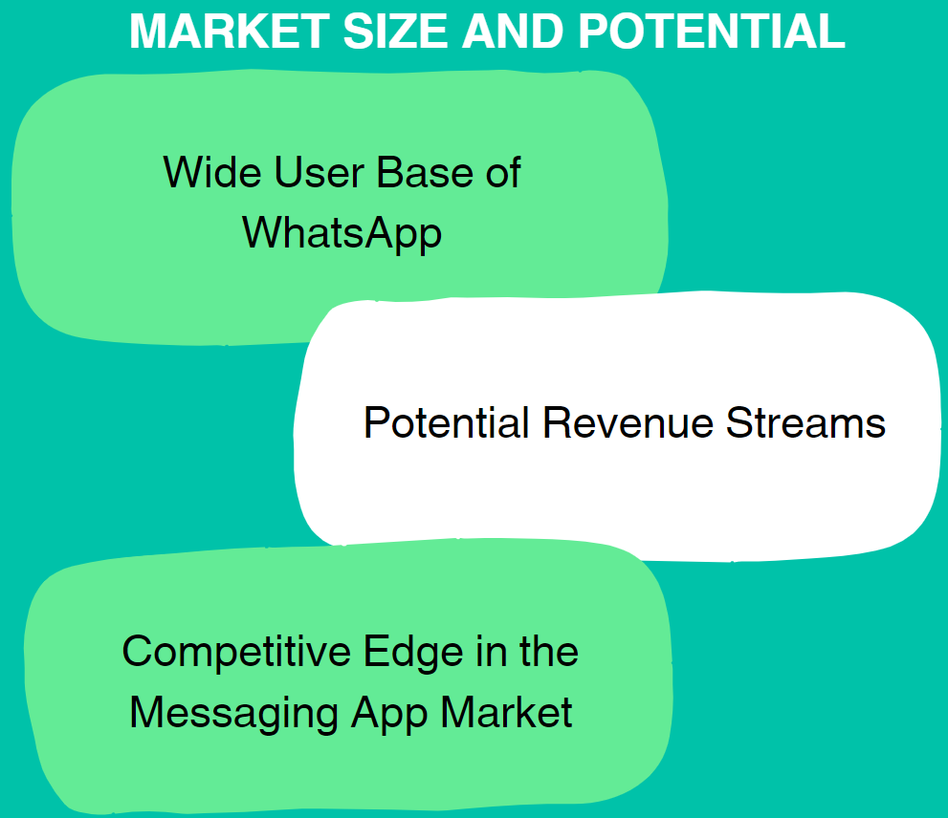
Market analysis

Slide 12
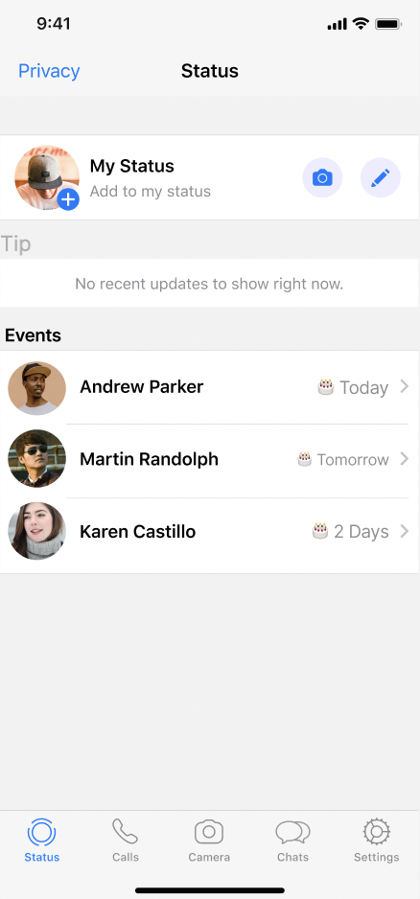
Prototype
Integration of events under the Status feature

Slide 13
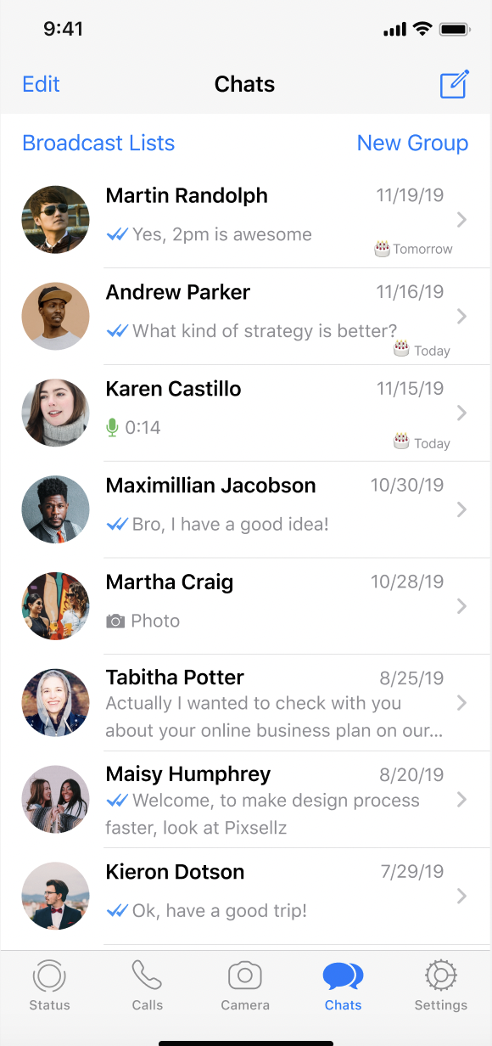
Prototype
Notifications within the chat window

Slide 14
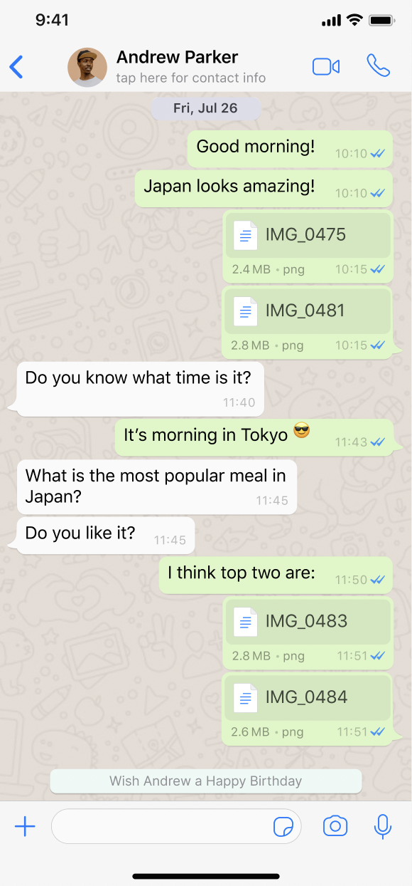
Prototype
Group notifications for upcoming events

Slide 15
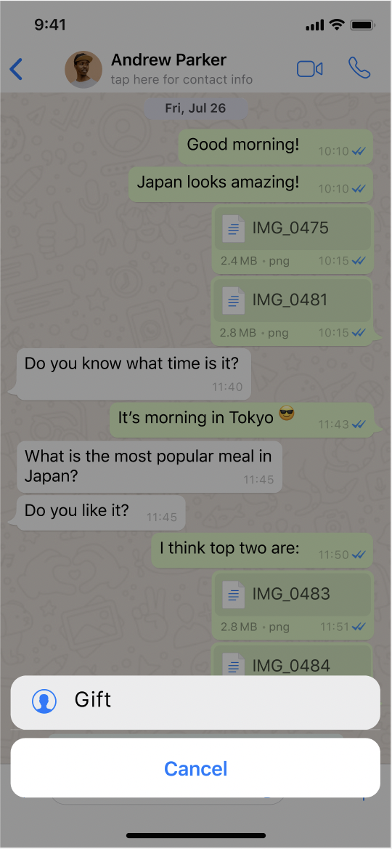
Prototype
Payment integration using gift cards, with the option for B2B integration (Amazon Gift Cards)

Slide 16
Prototype

